Slide 1
Line Clipping Algorithms
Notes:
CS5600 Computer Graphics
Spring 2006
Utah School of Computing
CS5600 Computer Graphics
Spring 2006
Utah School of Computing

Slide 2







Cases for Clipping Lines
B
H
C
E
J
A
clip
rectangle
G
I
Prepared by Narendra V G CSE MIT
Notes:
CS5600 Computer Graphics
Spring 2006
Utah School of Computing
CS5600 Computer Graphics
Spring 2006
Utah School of Computing

Slide 3
Cases for Clipping Lines
B
C
A
Prepared by Narendra V G CSE MIT
Notes:
CS5600 Computer Graphics
Spring 2006
Utah School of Computing
CS5600 Computer Graphics
Spring 2006
Utah School of Computing

Slide 4
Clipping Targets
Points
Lines
Polygons
Text
Other Objects
Prepared by Narendra V G CSE MIT
Notes:
CS5600 Computer Graphics
Spring 2006
Utah School of Computing
CS5600 Computer Graphics
Spring 2006
Utah School of Computing

Slide 5
Clipping
One of oldest problems in graphics
We will study problem of Clip Line against an axis-oriented rectangular window
Many variations of this problem
Prepared by Narendra V G CSE MIT
Notes:
CS5600 Computer Graphics
Spring 2006
Utah School of Computing
CS5600 Computer Graphics
Spring 2006
Utah School of Computing

Slide 6
General Problem
Clip one object wrt another object
Requires intersection calculations
Interesting problem
Floating point causes difficulties
Relates to many other problems
Graphics does things fast….
Prepared by Narendra V G CSE MIT
Notes:
CS5600 Computer Graphics
Spring 2006
Utah School of Computing
CS5600 Computer Graphics
Spring 2006
Utah School of Computing

Slide 7
Cohen-Sutherland
Line Clipping
Notes:
CS5600 Computer Graphics
Spring 2006
Utah School of Computing
CS5600 Computer Graphics
Spring 2006
Utah School of Computing

Slide 8
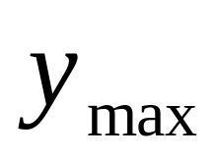
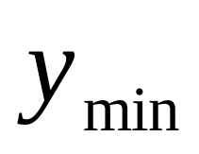
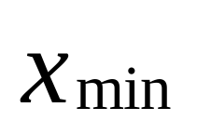
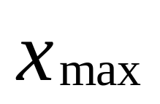
Region Outcodes
1001
1000
1010
0001
0000
0010
0101
0100
0110
Prepared by Narendra V G CSE MIT
Notes:
CS5600 Computer Graphics
Spring 2006
Utah School of Computing
CS5600 Computer Graphics
Spring 2006
Utah School of Computing

Slide 9


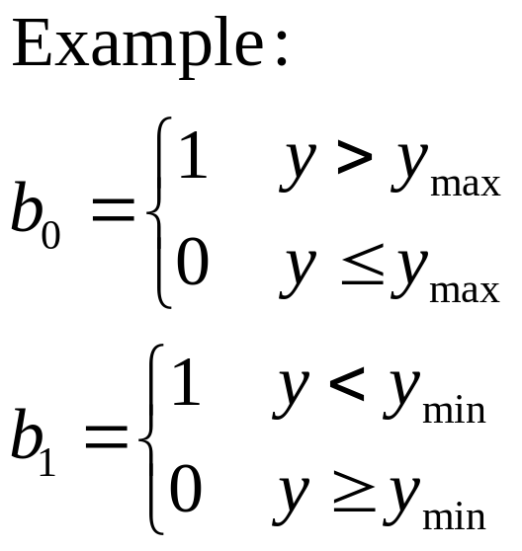






Cohen-Sutherland Clipping:
“Outcodes”
1
0
1
0
Prepared by Narendra V G CSE MIT
Notes:
CS5600 Computer Graphics
Spring 2006
Utah School of Computing

Slide 10
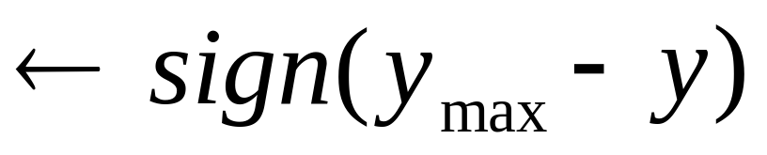
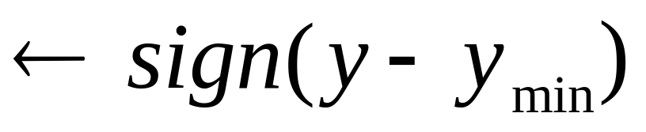
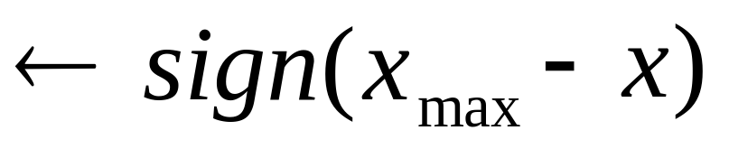
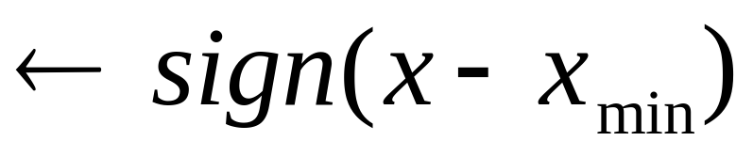
Look at Sign Bits (neg 1)
Bit 1
Bit 2
Bit 3
Bit 4
Prepared by Narendra V G CSE MIT
Notes:
CS5600 Computer Graphics
Spring 2006
Utah School of Computing
CS5600 Computer Graphics
Spring 2006
Utah School of Computing

Slide 11
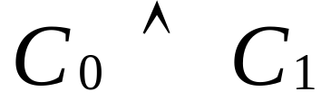

Need to Classify Endpoint
Look at
What does it tell us?
“trivial reject”
Both ends in a row or column outside
Prepared by Narendra V G CSE MIT
Notes:
CS5600 Computer Graphics
Spring 2006
Utah School of Computing
CS5600 Computer Graphics
Spring 2006
Utah School of Computing

Slide 12
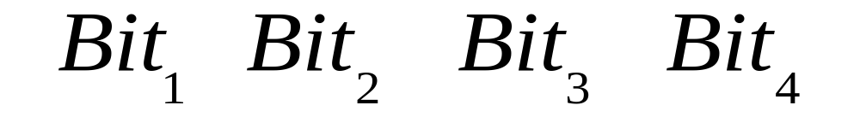
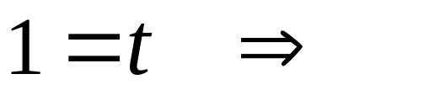
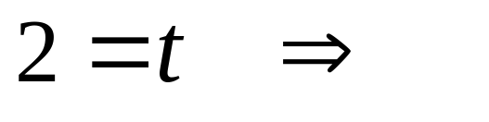
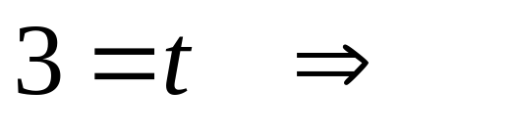
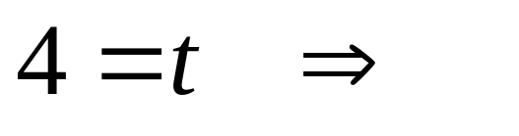
Region Outcodes
Bit above window
Bit below window
Bit right of window
Bit left of window
Prepared by Narendra V G CSE MIT
Notes:
CS5600 Computer Graphics
Spring 2006
Utah School of Computing
CS5600 Computer Graphics
Spring 2006
Utah School of Computing

Slide 13
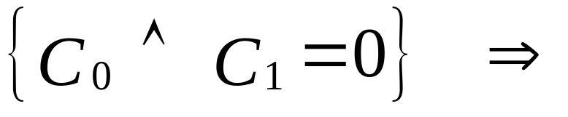
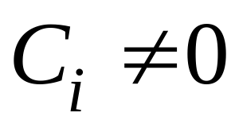
Classify Endpoint
Endpoints may not
be in window
Clip an end for which
Test again. May need more.
Prepared by Narendra V G CSE MIT
Notes:
CS5600 Computer Graphics
Spring 2006
Utah School of Computing
CS5600 Computer Graphics
Spring 2006
Utah School of Computing

Slide 14




Cohen-Sutherland Clipping:
Trivial Acceptance: O(P0) = O(P1) = 0
1001
1000
1010
P1
0001
0000
0010
P0
0101
0100
0110
Prepared by Narendra V G CSE MIT
Notes:
CS5600 Computer Graphics
Spring 2006
Utah School of Computing

Slide 15
Cohen-Sutherland Clipping:
Trivial Rejection: O(P0) & O(P1) ≠ 0
P0
1001
1000
1010
P1
P0
0001
0000
0010
P0
P1
P1
0101
0100
0110
Prepared by Narendra V G CSE MIT
Notes:
CS5600 Computer Graphics
Spring 2006
Utah School of Computing

Slide 16
Cohen-Sutherland Clipping:
O(P0) =0 , O(P1) ≠ 0
1001
1000
1010
P0
0001
0000
0010
P1
P1
P0
P0
0101
0100
0110
P1
Prepared by Narendra V G CSE MIT
Notes:
CS5600 Computer Graphics
Spring 2006
Utah School of Computing

Slide 17
Cohen-Sutherland Clipping:
O(P0) & O(P1) ≠ 0
1001
1000
1010
P0
0001
0000
0010
P1
0101
0100
0110
Prepared by Narendra V G CSE MIT
Notes:
CS5600 Computer Graphics
Spring 2006
Utah School of Computing

Slide 18
Cohen-Sutherland Clipping: The Algorithm
Compute the outcodes for the two vertices
Test for trivial acceptance or rejection
Select a vertex for which outcode is not zero
  There will always be one
Select the first nonzero bit in the outcode to define the boundary against which the line segment will be clipped
Compute the intersection and replace the vertex with the intersection point
Compute the outcode for the new point and iterate
Prepared by Narendra V G CSE MIT
Notes:
CS5600 Computer Graphics
Spring 2006
Utah School of Computing

Slide 19
Cohen-Sutherland Line Clipping
D
C
1001
1000
1010
I
B
A
H
G
0001
0000
0010
F
0101
0100
0110
E
Prepared by Narendra V G CSE MIT
Notes:
CS5600 Computer Graphics
Spring 2006
Utah School of Computing
CS5600 Computer Graphics
Spring 2006
Utah School of Computing

Slide 20
Cohen-Sutherland Line Clipping
D
1001
C
1000
1010
I
B
H
A
0001
0000
G
0010
F
0101
E
0100
0110
Prepared by Narendra V G CSE MIT
Notes:
CS5600 Computer Graphics
Spring 2006
Utah School of Computing
CS5600 Computer Graphics
Spring 2006
Utah School of Computing

Slide 21
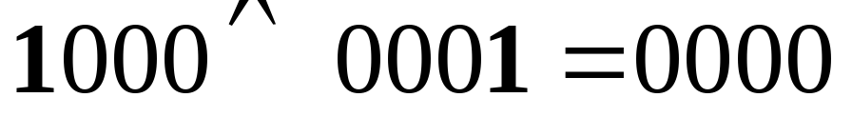

Initial Outcode Calculations
OC(D)=1000; OC(A)=0001
OC(E)=0100; OC(I)=1010
Prepared by Narendra V G CSE MIT
Notes:
CS5600 Computer Graphics
Spring 2006
Utah School of Computing
CS5600 Computer Graphics
Spring 2006
Utah School of Computing

Slide 22
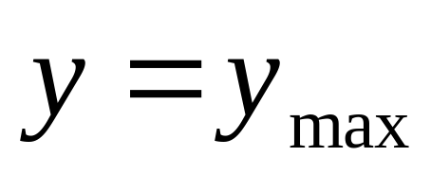
Clip and Continue
Clip against the top boundary
Calculate B. Keep AB
Calculate H . Keep EH
Prepared by Narendra V G CSE MIT
Notes:
CS5600 Computer Graphics
Spring 2006
Utah School of Computing
CS5600 Computer Graphics
Spring 2006
Utah School of Computing

Slide 23
Cohen-Sutherland Line Clipping
B
A
H
G
F
E
Prepared by Narendra V G CSE MIT
Notes:
CS5600 Computer Graphics
Spring 2006
Utah School of Computing
CS5600 Computer Graphics
Spring 2006
Utah School of Computing

Slide 24
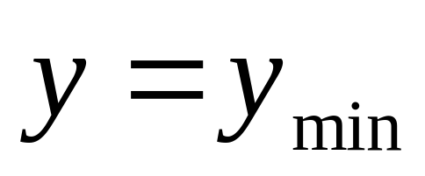
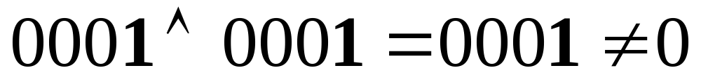
Clip and Continue
Clip against the bottom boundary
Now test and reject AB because
OC(A)=0001 and OC(B)=0001;
Reject AB on outcode basis
Prepared by Narendra V G CSE MIT
Notes:
CS5600 Computer Graphics
Spring 2006
Utah School of Computing
CS5600 Computer Graphics
Spring 2006
Utah School of Computing

Slide 25

Outcode Calculations
OC(H)=0010; OC(E)=0100
Since product is 0, process HE to get FH
Prepared by Narendra V G CSE MIT
Notes:
CS5600 Computer Graphics
Spring 2006
Utah School of Computing
CS5600 Computer Graphics
Spring 2006
Utah School of Computing

Slide 26
Cohen-Sutherland Line Clipping
1001
1000
1010
H
0001
G
0010
0000
F
0101
0100
0110
Prepared by Narendra V G CSE MIT
Notes:
CS5600 Computer Graphics
Spring 2006
Utah School of Computing
CS5600 Computer Graphics
Spring 2006
Utah School of Computing

Slide 27
Outcode Calculations
OC(F)=0000; OC(H)=0010
Since product is 0, process HF to get GF
Prepared by Narendra V G CSE MIT
Notes:
CS5600 Computer Graphics
Spring 2006
Utah School of Computing
CS5600 Computer Graphics
Spring 2006
Utah School of Computing

Slide 28
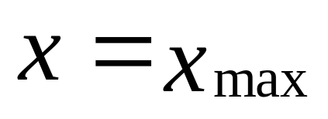
Clip and Continue
Clip against the right boundary
Get GF
Done
Prepared by Narendra V G CSE MIT
Notes:
CS5600 Computer Graphics
Spring 2006
Utah School of Computing
CS5600 Computer Graphics
Spring 2006
Utah School of Computing

Slide 29
Cohen-Sutherland Line Clipping
G
F
Prepared by Narendra V G CSE MIT
Notes:
CS5600 Computer Graphics
Spring 2006
Utah School of Computing
CS5600 Computer Graphics
Spring 2006
Utah School of Computing

Slide 30
Process Ends
Do not have to do x _{min}
Normally it would continue to last stage
Prepared by Narendra V G CSE MIT
Notes:
CS5600 Computer Graphics
Spring 2006
Utah School of Computing
CS5600 Computer Graphics
Spring 2006
Utah School of Computing

Slide 31
When is this algorithm good?
If it trivally rejects(accepts) most cases
Good if window large wrt to data
Good if window small wrt to data
Eg, it works well in extreme cases with mostly trivial decisions
Prepared by Narendra V G CSE MIT
Notes:
CS5600 Computer Graphics
Spring 2006
Utah School of Computing
CS5600 Computer Graphics
Spring 2006
Utah School of Computing

Slide 32
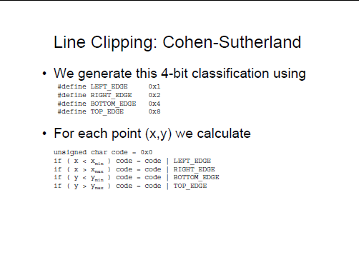
08/29/13 11/07/26
Prepared by Narendra V G CSE MIT
Notes:
CS5600 Computer Graphics
Spring 2006
Utah School of Computing

Slide 33
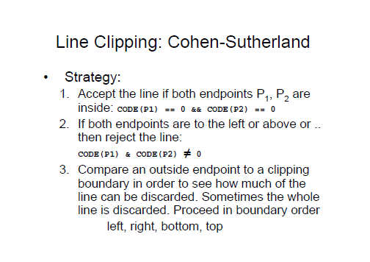
08/29/13 11/07/26
Prepared by Narendra V G CSE MIT
Notes:
CS5600 Computer Graphics
Spring 2006
Utah School of Computing

Slide 34
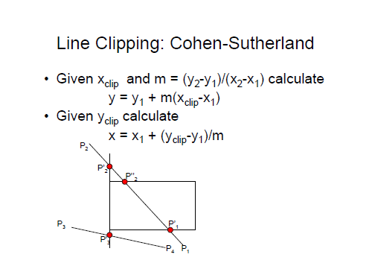
08/29/13 11/07/26
Prepared by Narendra V G CSE MIT
Notes:
CS5600 Computer Graphics
Spring 2006
Utah School of Computing

Slide 35
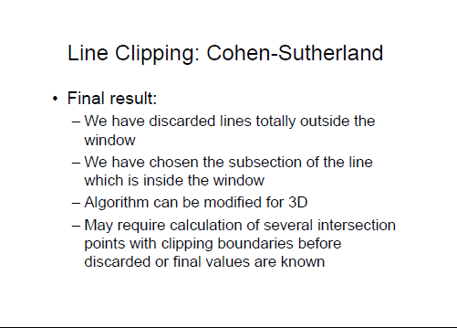
08/29/13 11/07/26
Prepared by Narendra V G CSE MIT
Notes:
CS5600 Computer Graphics
Spring 2006
Utah School of Computing

Slide 36
Cohen-Sutherland Clipping:
Advantages/Extension
Easily extended to 3 dimensions by adding two bits to the outcode for the z axis.
Calculations then reduce to intersection of line with plane
Algorithm most efficient when most segments can either be trivially accepted or trivially rejected
Prepared by Narendra V G CSE MIT
Notes:
CS5600 Computer Graphics
Spring 2006
Utah School of Computing

